Slide 1
Data Transformation
Patrick Mathias
Lesson 5
DLMP Fall 2021

Slide 2
Goal
Learn how to use dplyr to transform data frames
Appreciate the role of piping in facilitating data transformation
Objectives
List the major forms of data transformation implemented in dplyr
Use the pipe operator to pass the output of one function as an input to the next function
Create new calculated columns not found in the original data frame
Notes:
Our goals for this session are to learn to use some of the functions in the dplyr package to tackle some of the most common challenges in data transformation. In addition we'll be using a special tool called a pipe operator to string together individual functions into a data analysis pipeline.

Slide 3
Reordering Rows

Slide 4

arrange()
Order rows by values in a column
= Number of rows
= Number of Columns
Notes:
Arrange doesn’t so much change your data as much as organize it
Often when exploring your data you’ll be interested in ordering the rows according to values in a specific column or columns. That’s what arrange() does. It let’s you focus on the most important parts of your data by rearranging and organizing it.

Slide 5
arrange()
Order rows by values in a column
arrange(data,... )
data frame to transform
name(s) of columns to arrange by
Notes:
arrange conforms to the general syntax of dplyr function. The data frame is your first argument. After that you can list one or more columns, each separated by a comma, to arrange the data frame by.

Slide 6
arrange()
Order rows by values in a column
arrange(covid_testing, first_name)
mrn | first_name | last_name
5000876 | sarella | stark
5006017 | alester | stark
5001412 | jhezane | targaryen
5000533 | penny | targaryen
mrn | first_name | last_name
5006017 | alester | stark
5001412 | jhezane | targaryen
5000533 | penny | targaryen
5000876 | sarella | stark
Notes:
In this example we are arranging covid_testing data frame by the first_name in ascending alphabetical order

Slide 7
arrange()
Order rows by values in a column
arrange(covid_testing, desc(mrn))
mrn | first_name | last_name
5000876 | sarella | stark
5006017 | alester | stark
5001412 | jhezane | targaryen
5000533 | penny | targaryen
mrn | first_name | last_name
5006017 | alester | stark
5001412 | jhezane | targaryen
5000876 | sarella | stark
5000533 | penny | targaryen
Notes:
By default arrange will order the rows from smallest to largest, from a to z, or from earliest date to latest depending on what type of data is in the column that we're arranging. We can reverse this by wrapping our column of interest in the desc() function.
So in this example our output is a data frame in ascending MRN order.

Slide 8
Your Turn 1
Open “05 – Transform.Rmd”
The column ct_value contains the cycle threshold (Ct) for the real-time PCR that generated the final result.
How might you use arrange() to determine the highest and lowest Ct result in the dataset?

Slide 9
Pop Quiz
The default behavior of arrange() is to order from lower to higher values.
When might arrange() place "1000" before "50"?

Slide 10
The Pipe Operator: |>

Slide 11
Data Analysis Steps
day_10 <- filter(covid_testing, pan_day <= 10)
Which patient locations sent COVID testing in the first 10 days of the pandemic?
day_10 <- select(day_10, clinic_name)
day_10 <- arrange(day_10 , clinic_name)
1. Filter tests to those on pandemic day less than 10
2. Select the column that contains ordering location
3. Arrange those columns by location
Notes:
For instance, in the context of the covid_testing data set, we might be interested in which clinical areas were the first to begin ordering our COVID test.
To accomplish this we're going to need to first filter to the rows that contain orders from the first 10 days of the pandemic. Then we'll select the column that contains the ordering location, and finally we'll arrange that column so that it's sorted by location.
→
Using the methodology we've learned so far this is how we would likely get this task done. We would first filter our original dataset specifying that we want pan_day, which contains the pandemic day of the order, to be less than or equal to 10. We'll assign that to a new object called day_10.
then we would select one column, the clinic_name column, from that dataset, we can overwrite and assign that back to day_10.
Finally we'll want to arrange that data set by the clinic_name column so we can get a more organized picture of the ordering locations.
Now if I put on my editorial hat I'd say that this is organized code, but it's not very efficient. We've written day_10 5 times here. We're creating the day_10 object and then overwriting it again and again. So is there a better way?

Slide 12
Data Analysis Steps
day_10 <- arrange(
select(
filter(
covid_testing,
pan_day <= 10
),
clinic_name
),
clinic_name
)
Notes:
There is this way.
Here we are nesting these functions one within the other. When nesting functions the innermost function is evaluated first followed sequentially by the next inner ones.
We can see that we have made the code much more efficient but at a significant price. The code is really complicated to look at, it’s not at all obvious what the code is trying to accomplish. The arguments for functions are spatially far away from the names of the functions themselves.
What would be helpful when performing data analyses such as these would be a syntax that was both efficient as well as human readable.

Slide 13
The Pipe Operator |>
Passes result on left into first argument of function on right.
covid_testing
|>
filter(____, pan_day <= 10)
filter(covid_tesing, pan_day <= 10)
covid_tesing |> filter(pan_day <= 10)
Notes:
This is exactly what the pipe operator does.
The pipe operator is this percent, greater than, percent symbol. It's a tool that we use to glue the pieces of our analysis together into one pipeline.
The pipe operator does something very simple but at the same time incredible useful. It takes the product of whatever is on the left and puts it into the function on the right.
So for example, the two lines of code in the gray box do exactly the same thing.
There are a whole bunch of reasons as to why this is a useful thing but for me, one of the most important reasons is that it turns computer code into something that is almost legible as human language.
You could essentially read the second line of code as “Take the covid_testing data frame, and then filter the pan_day column to rows that are less than or equal to 10.”

Slide 14
Data Analysis Steps
day_10 <- arrange(
select(
filter(
covid_testing,
pan_day <= 10
),
clinic_name
),
clinic_name
)
Notes:
The advantage of this is even more clear when performing a more complicated analysis such as this one. You can take this code, which is essentially illegible, and transform it into the code on the following slide.

Slide 15
Data Analysis Steps
covid_testing |>
filter(pan_day <= 10) |>
select(clinic_name) |>
arrange(clinic_name)
Notes:
The code here is far more succinct. It's essentially self describing since it’s written in a sequential, essentially human readable format.
The pipe operator allows us to form chains that accomplish complicated data transformation operations but which are made up of very simple, self-contained, building blocks. So we're able to make something complex by joining together many simple elements that are easy to understand in isolation.
An additional benefit is that it makes it easier to actually write code because it's much easier to translate our thoughts into an analytical pipeline.

Slide 16
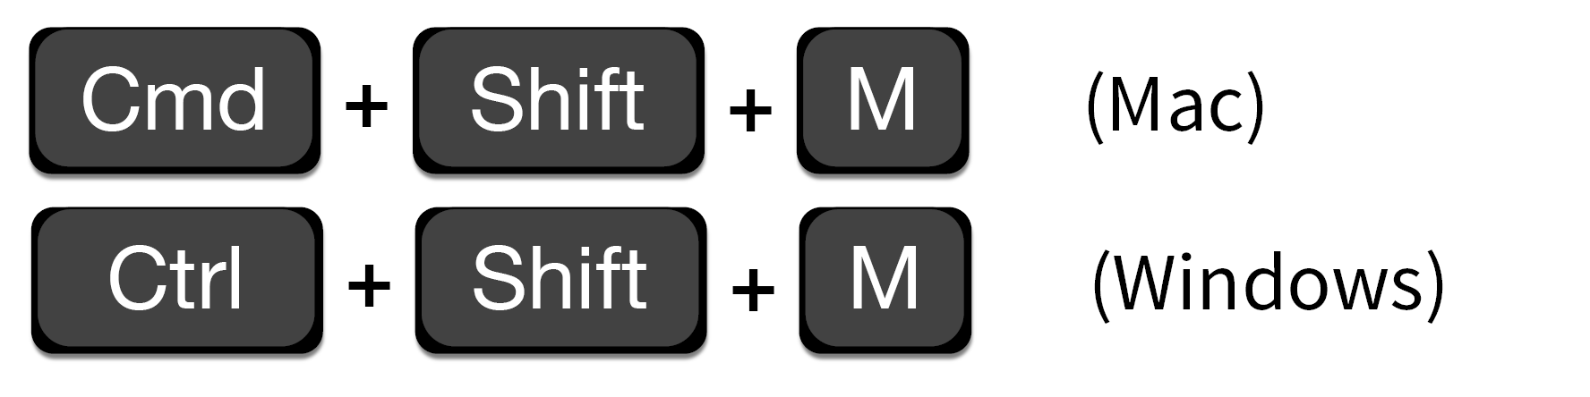
Shortcut to type |>
RStudio needs to be configured to use native pipe |>
Previous version of pipe: %>%
Notes:
This pipe operator is going to be so useful to you you might as well learning a shortcut key that will type it out for you.
You can use either command, shift M on a mac or Ctrl shift M on a PC to save your fingers a few inches of movement.

Slide 17

Scene
The PICU would like a word with you because of a recent incident involving a delay in results for a patient who required a AGP
They had to wait over 10 hours before the procedure could begin
You decide to investigate… WITH DATA
Notes:
OK so let's put this to action. Imagine you get a call from the medical director of the PICU. She wants to know what's going on in your lab! She had to wait 10 hours for a COVID test result, meanwhile there was a patient who was awaiting an aerosol generating procedure!
You decide to investigate using the covid_testing data set

Slide 18
Your Turn 2
Use |> to write a sequence of three functions that:
1. Filters to tests from the clinic (clinic_name) of "picu"
2. Selects the column with the receive to verify turnaround time (rec_ver_tat) as well as the day from start of the pandemic (pan_day)
3. Arrange the ` pan_day ` from highest to lowest
Using <-, assign the result to a new variable, call it whatever you want.

Slide 19

Isolating data
Extract variables with select()
Extract rows with filter()
Arrange rows, with arrange().
Notes:
So far we’ve covered functions whose primary job is to reshape your data but don’t fundamentally tell you something about what’s inside of it.

Slide 20
Creating New Columns
Notes:
So now let's shift gears and discuss how we can derive new information from the raw data that we're provided

Slide 21

What is the mean and median collect to verify turnaround time by clinic?
Notes:
Say for example you’re interested in the total TAT from collect to verify for covid orders stratified by ordering clinic

Slide 22
Breaking down the analytical question
Total TAT for each test
Group tests by clinic
Calculate mean and median for each clinic
Notes:
To answer a question like the one we posed on the previous slide, it can help to break it down into the component steps that we need to take to get to the finish line.
In our data set we're provided with the collect to receive and Received to verify turn around times so we're going to have to add those together, then we're going to have to group by the clinics and then finally we'll need to calculate the mean and the median for each of the clinics.

Slide 23
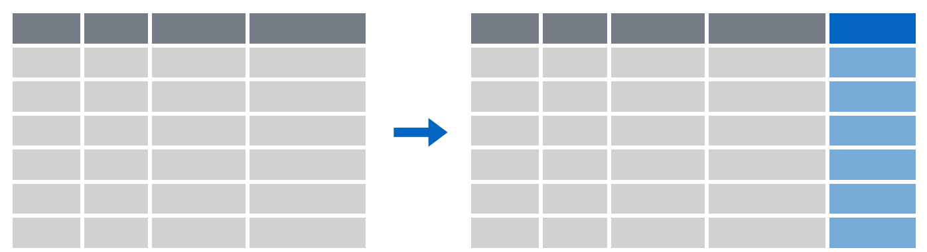
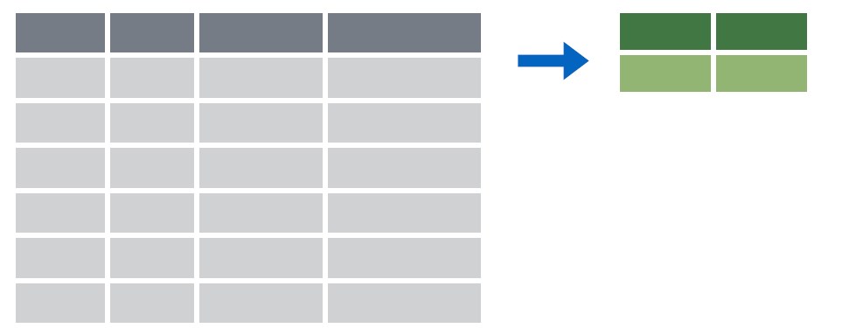
Deriving data
Make new variables with mutate()
Make summaries of data with summarize()
Notes:
To answer questions like these we’re going to need a new set of functions whose job is to derive new data from our original data frame. The two functions in dplyr to accomplish these types of tasks are mutate() which I will cover here and summarize() which Dan will discuss in the next session.

Slide 24

mutate()
Notes:
So lets dive in with the mutate() function.

Slide 25
mutate()
Creating new calculated columns
= Number of rows
↑ Number of Columns
Notes:
The goal of mutate() is very simple. You’ll feed in your original data frame and it’s going to kick out the same data frame with one or more new columns tacked onto the end based on calculations that you specify.

Slide 26
mutate()
Creating new calculated columns
Covid_testing |>
mutate(new_column = calculation)
function whose results will populate columns
name for new column
equals
Notes:
The syntax is going to look similar to the functions we saw earlier but with a small change. As before, the first argument is the original data frame, which gets piped into mutate. Then you specify the name of the new column you want to add, you use and equals sign to set it equal you a calculation. This calculation will be run on each row of your data frame and the result will populate each row of the new column.

Slide 27
mutate()
calculation can involve another column in the data frame
Creating new calculated columns
covid_testing |>
mutate(c_r_tat_mins = col_rec_tat * 60)
mrn | col_rec_tat | rec_ver_tat
5000876 | 29.5 | 11.5
5006017 | 3.6 | 5
5001412 | 1.4 | 5.2
5000533 | 2.3 | 5.8
mrn | col_rec_tat | rec_ver_tat | c_r_tat_mins
5000876 | 29.5 | 11.5 | 1770
5006017 | 3.6 | 5 | 216
5001412 | 1.4 | 5.2 | 84
5000533 | 2.3 | 5.8 | 138
Notes:
Let’s look at an example. Currently our turnaround times are coded in hours but maybe we want to know the turnaround time in minutes.
What we could do is create a new column, called for instance “c_r_tat_mins ” and set that equal to 60 times the col_rec_tat column.
In this situation mutate() would perform that calculation on each row and place the result in a new column at the right most part of our data frame.

Slide 28
Your Turn 3
Create a new column using the mutate() function that contains the total TAT (sum of col_rec_tat and rec_ver_tat)

Slide 29
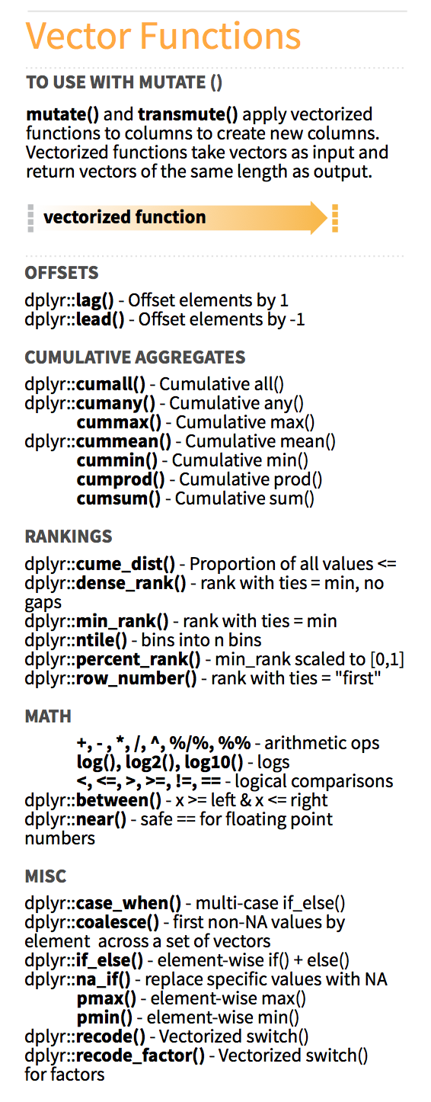
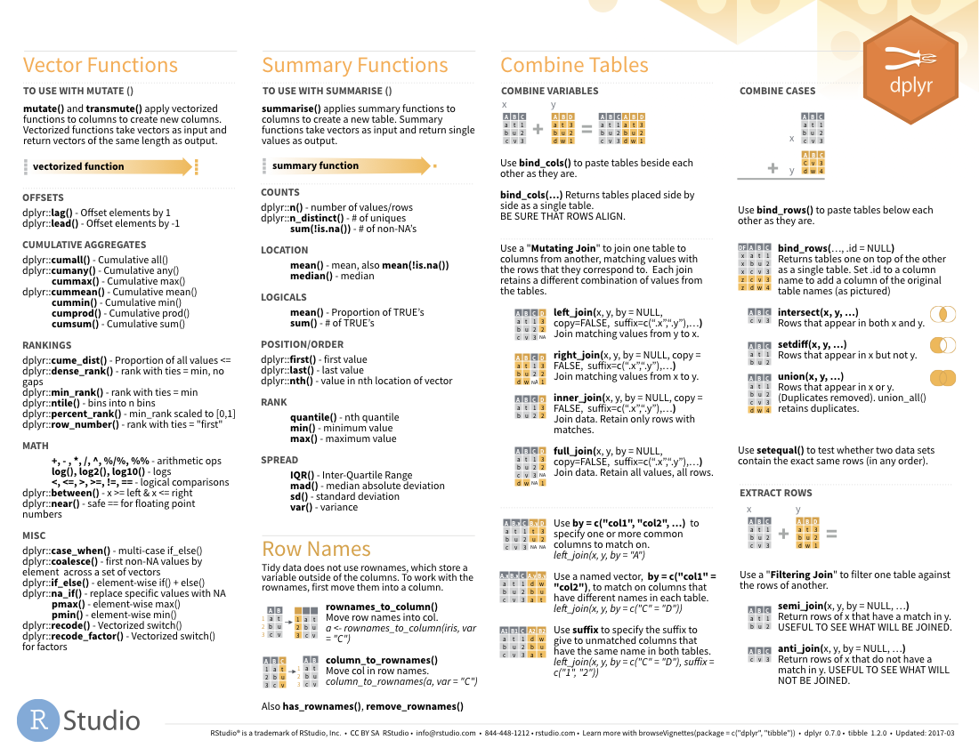

Functions to use in mutate()
on back
Notes:
There are tons of functions that you can use in the context of a mutate function, beyond just mathematics there are functions for ranking for creating cumulative aggregates, and many more found in the dplyr cheat sheet.

Slide 30
Recap
arrange() sorts data based on the data type of the column(s) used to sort
Pipes (|>) allow you to sequentially apply functions to a data frame efficiently
mutate() adds a column to the data frame that may be based on calculations on one or more other columns

Slide 31
What else?

Slide 32
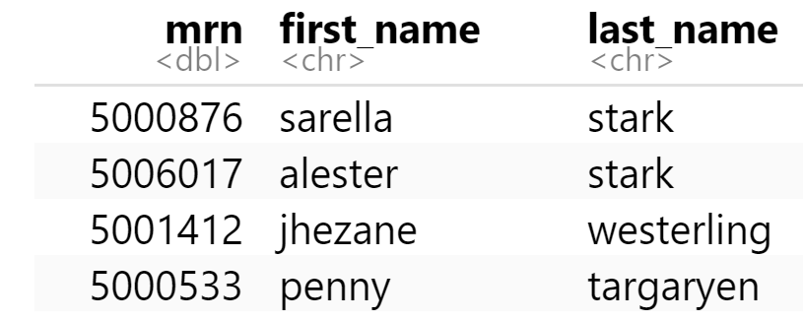
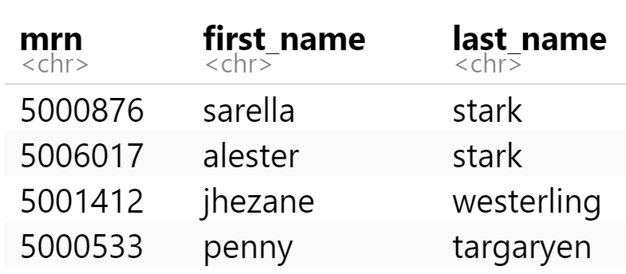
mutate()
Function to "coerce" one type of data into another type of data
Replacing columns
covid_testing |>
mutate(mrn = as.character(mrn))

Slide 33
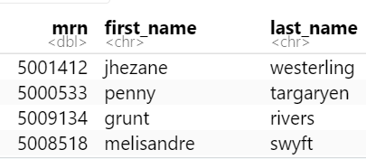
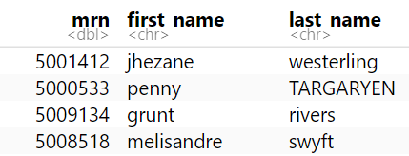
mutate()
Conditionally replacing values
covid_testing |>
mutate(last_name = if_else(last_name=="targaryen", "TARGARYEN",last_name))

Slide 34
Goal
Learn how to use dplyr to transform data frames
Appreciate the role of piping in facilitating data transformation
Objectives
List the major forms of data transformation implemented in dplyr
Use the pipe operator to pass the output of one function as an input to the next function
Create new calculated columns not found in the original data frame
Notes:
Our goals for this session are to learn to use some of the functions in the dplyr package to tackle some of the most common challenges in data transformation. In addition we'll be using a special tool called a pipe operator to string together individual functions into a data analysis pipeline.

